Slide 1
Arctic Science and Research needs
USARC-ADAC Synergies
David M. Kennedy
Chair, US Arctic Research Commission
2 June 2021

Slide 2
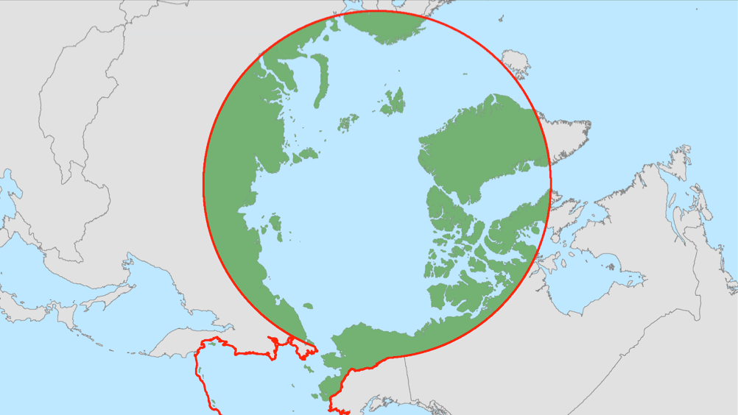
US Arctic Research Commission:
• Develops national Arctic research policy
• Facilitates Arctic research coordination
• Reviews federal Arctic research programs
• Recommends improvements for data sharing
• Facilitates cooperation w/Alaska & the international research community
PRIORITY GOALS
Goal 1. Advance Arctic Infrastructure
Goal 2. Assess Arctic Natural Resources
Goal 3. Observe, Understand and Forecast Arctic Environmental Change
Goal 4. Improve Community Health and Well-Being
Goal 5. Enhance International Scientific Cooperation in the Arctic
Notes:
5 key tasks of the USARC, as a federal agency.
FYI, the area within the red circle/shape is the Arctic region, as defined in US law (Arctic Research and Policy Act of 1984, as amended)

Slide 3
SYNERGY 1: Arctic Infrastructure
New technologies focused on sustainability, efficiency and renewables
  Remote Unmanned Aircraft System (UAS) Inspection and Response Team Development in the Bering Strait Region
Identification and assessment of at-risk assets
  Landfill and Sewage lagoons at risk of erosion
  Arctic Facilities and Infrastructure Environmental Change Index
Adaptive engineering
  Updates to Alaska’s Engineering Atlas

Slide 4
SYNERGY 2: Arctic Regional Resilience
Research into natural or anthropogenic disaster prevention and response
  Coastal inundation model
The rural infrastructure gap: how to assess and resolve unmet needs
  Arctic Facilities and Infrastructure Environmental Change Index
Community-based observer networks
Oil spill response
  ERMA training, local oil spill response

Slide 5
SYNERGY 3: Arctic environmental change
Arctic marine ecosystems
  Arctic Ice Condition Index (ARCTICE)
Monitoring Arctic change
  High resolution Modeling of Arctic Sea Ice and Currents

Slide 6
SYNERGY 4: Arctic Research Data, Models, Tools, and Technology
Vessel tracking data/geofencing and bathymetric surveying
  Using Vessel Tracking Data to Prioritize Bathymetric Surveying
Arctic-specific applications for advanced technologies
  Exploring Enhancements to Arctic Communications and Domain Awareness using the ASF CubeSat Antenna Farm Experiment (CAFE)
Focus on data/knowledge/information challenges associated with co-production of knowledge
Modeling of Arctic sea ice and currents

Slide 7


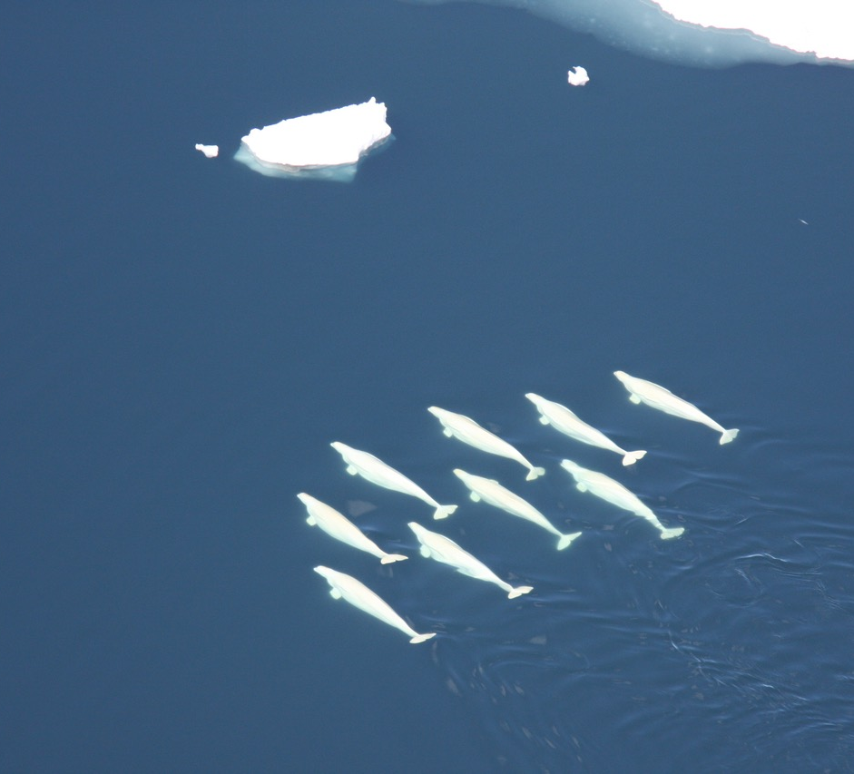
Questions?

